Slide 1
Demand Analysis
Team Geeks
Notes:
We are team geeks. Today I give a brief on our software requirement analysis.

Slide 2
CONTENTS
01
Project introduction
02
Project content
03
Project planning
&team division
Notes:
I will start with an overall introduction to our project, then our project development content, and finaly project plan and division of labor.

Slide 3
PART ONE
Project development
introduction
Notes:
For the first part of our presentation, I will talk about the background, development purpose, importance of our project.

Slide 4
Project Context
1
Our demand
With the ever-increasing demands for public safety, crowd control, and operational efficiency, the need for real-time monitoring of people flow in various public settings has grown significantly.
2
Complex scenes
shopping malls, campuses, airports, events, and other environments
Notes:
With the rapid development of modern society, environmental protection and resource management have become global challenges. We are increasingly demanding on environment monitoring systems. It is not only required to track environmental changes, but also to support scientific research and policy making. However, traditional environment monitoring method has many limitations, such as untimely data collection, high cost and complicated data processing, which fails to meet our needs.

Slide 5
Project Purpose
Monitor pedestrian flow to ensure safety:
This platform is used to monitor the flow of people in public places in real time, helping to prevent overcrowding and accidents, and ensuring people's safety.
Clear requirements for easy development:
The project will list all the required features and requirements, making it clear to developers, testers, and users what needs to be done, ensuring that everyone is working towards the same direction.
Test software to ensure usability:
The platform will be used to test the software, ensuring that it is both reliable and user-friendly, allowing end users to easily monitor and manage foot traffic.
Notes:
Through this application, we hope to provide users with a convenient monitoring solutions to improve their perception of the environment.
Our solution provides an elegant, concise, prominent, and powerful user interface, providing vital functions such as alarm setting, report generation and historical data analysis.
The system will empower individuals, industries, and communities to make data-driven decisions that drive progress in productivity.

Slide 6

Project importance
The project provides managers with an efficient tool to better understand and manage people flow, thereby improving overall operational efficiency.
It can be used in many different situations, such as shopping malls, campuses, airports, events, and other environments
The project helps prevent overcrowding and potential safety accidents by monitoring the flow of people in real-time, thereby improving people's safety levels in various public places
Notes:
This project has the following significance: 1. Realize real-time monitoring and data collection of environmental parameters (such as temperature, humidity, air quality, etc.). 2. Users with different technical backgrounds can easily access and understand environmental data. 3. It can be used in many different situations, including agriculture, smart cities, industrial facilities, education and smart homes.。

Slide 7
Class Diagram
Function
Project content
Interface Prototype
Function description
Notes:
Next I‘ll cover our project content, which is divided into four parts

Slide 8
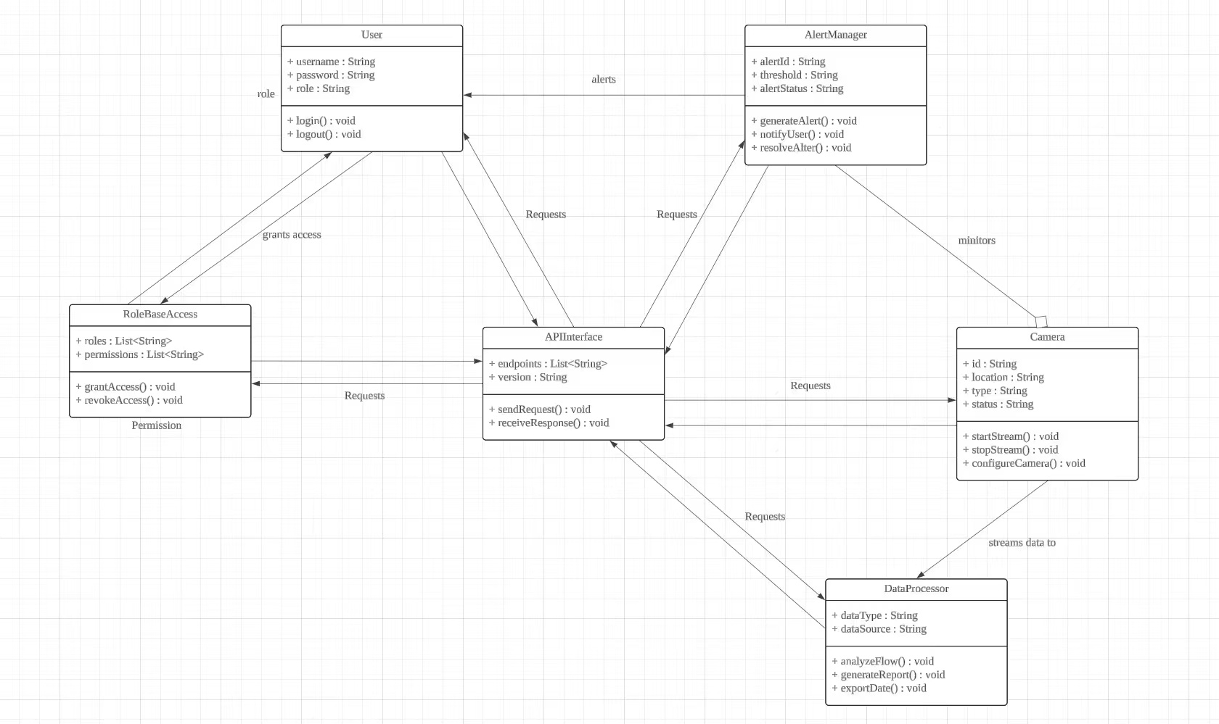
Class Diagram
Notes:
To begin with, this is a UML class diagram of key classes used in the back end of our project, including main data access objects, basic routing, authorization and database operations. Some of the auto generated class and internal utility functions are omitted for conciseness.

Slide 9

Function
01
Multi-Camera Integration
02
Real-Time Monitoring and Alerts
03
Data Analysis and Visualization
04
Role-Based Access
05
Search and Filtering
Notes:
Embedded Environmental Monitoring System Client strongly emphasizes availability, ensuring that users can seamlessly access and utilize the environmental data they need. The following key availability properties are crucial for our project:
First, it provides real-time data access. Users can monitor the air quality, humidity, temperature, and other parameters of your environment instantly, using data from embedded sensors.
Further more, the system has robust data processing capabilities. It can handle data from multiple sensors simultaneously, and ensure that the data is accurate and up to date.
Third, we offer high uptime. We aim to keep the system available at all times, with minimal downtime, so that users can access it whenever they need it.
After that, it is scalable. It can accommodate an increasing number of users and sensors as the project grows, without compromising performance.
Last but not least, it is cross-platform compatible. You can access the client application on various platforms, such as desktop and mobile devices, to ensure accessibility for a broad user base.

Slide 10
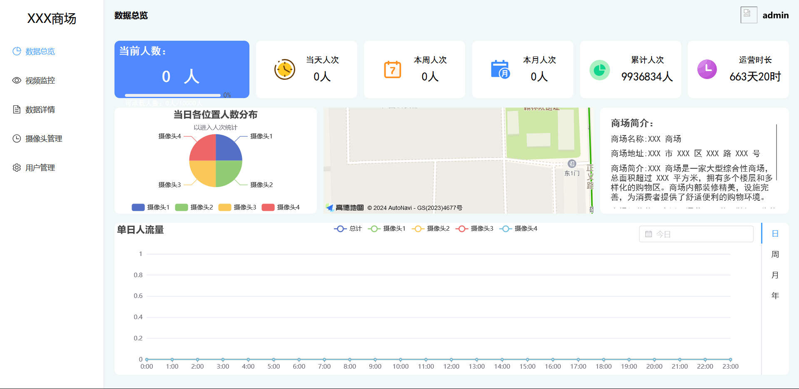
Interface prototype
Main interface
Notes:
On our home page, we present a data visualization dashboard that gives users a clear view of the information collected by the device. At the same time, our web page also has a quick access area for common functions, making it easier for users to use various functions. In addition, our website also has an announcement area to show users the latest announcements. Finally, our website also has a help section for answers to common questions that users may encounter during use.

Slide 11
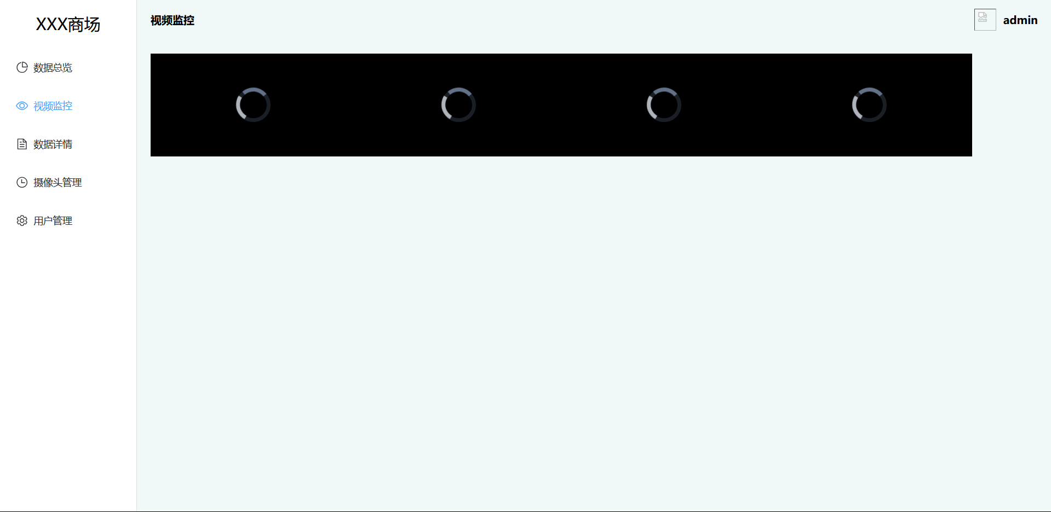
Interface prototype
Video monitoring
Notes:
For the device information interface, we have the three modules under development: device table, device map, and new device
Device table is mainly used to display the name of the person in charge of the device, contact info of the person in charge, the device address and the device status. Users can quickly access the devices they are responsible for, also having a good cense on the overall status of what they are in charge of.

Slide 12
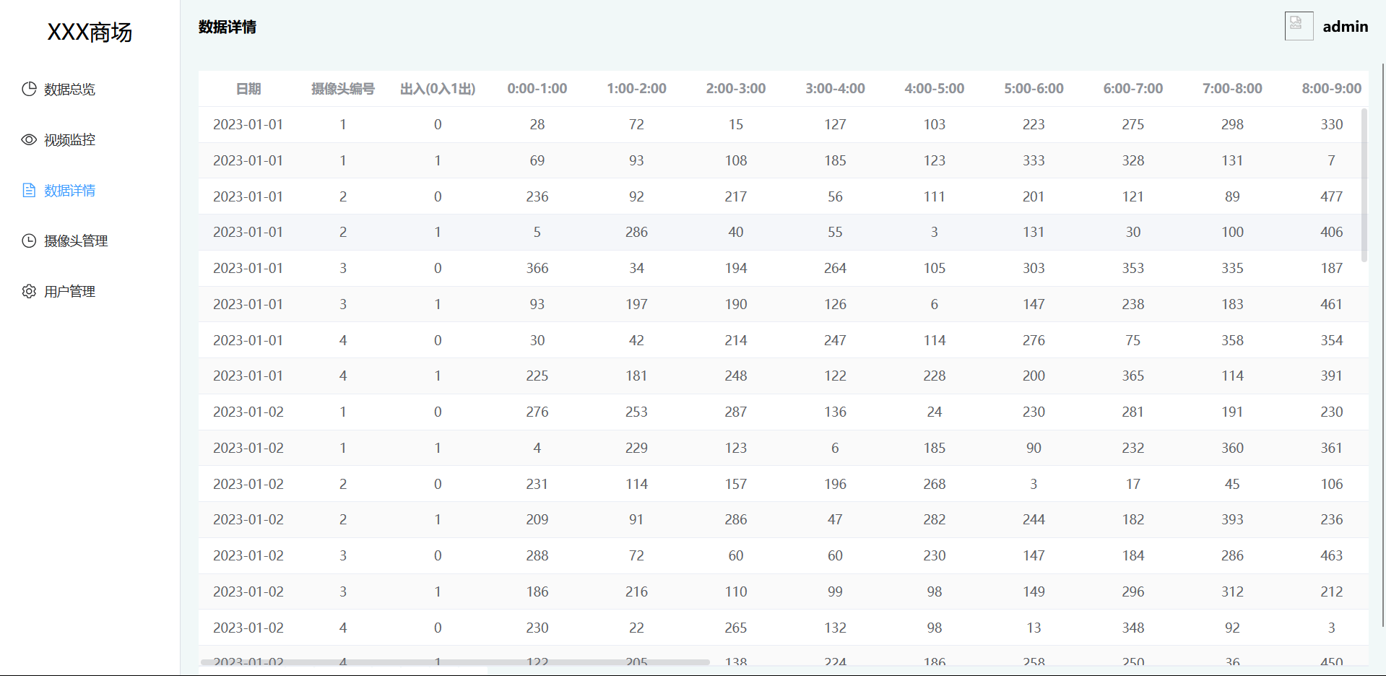
Interface prototype
Data details
Notes:
Device map shows the location of each device on a two-dimensional map. Allow users to more clearly understand the direct spatial location of each device.

Slide 13
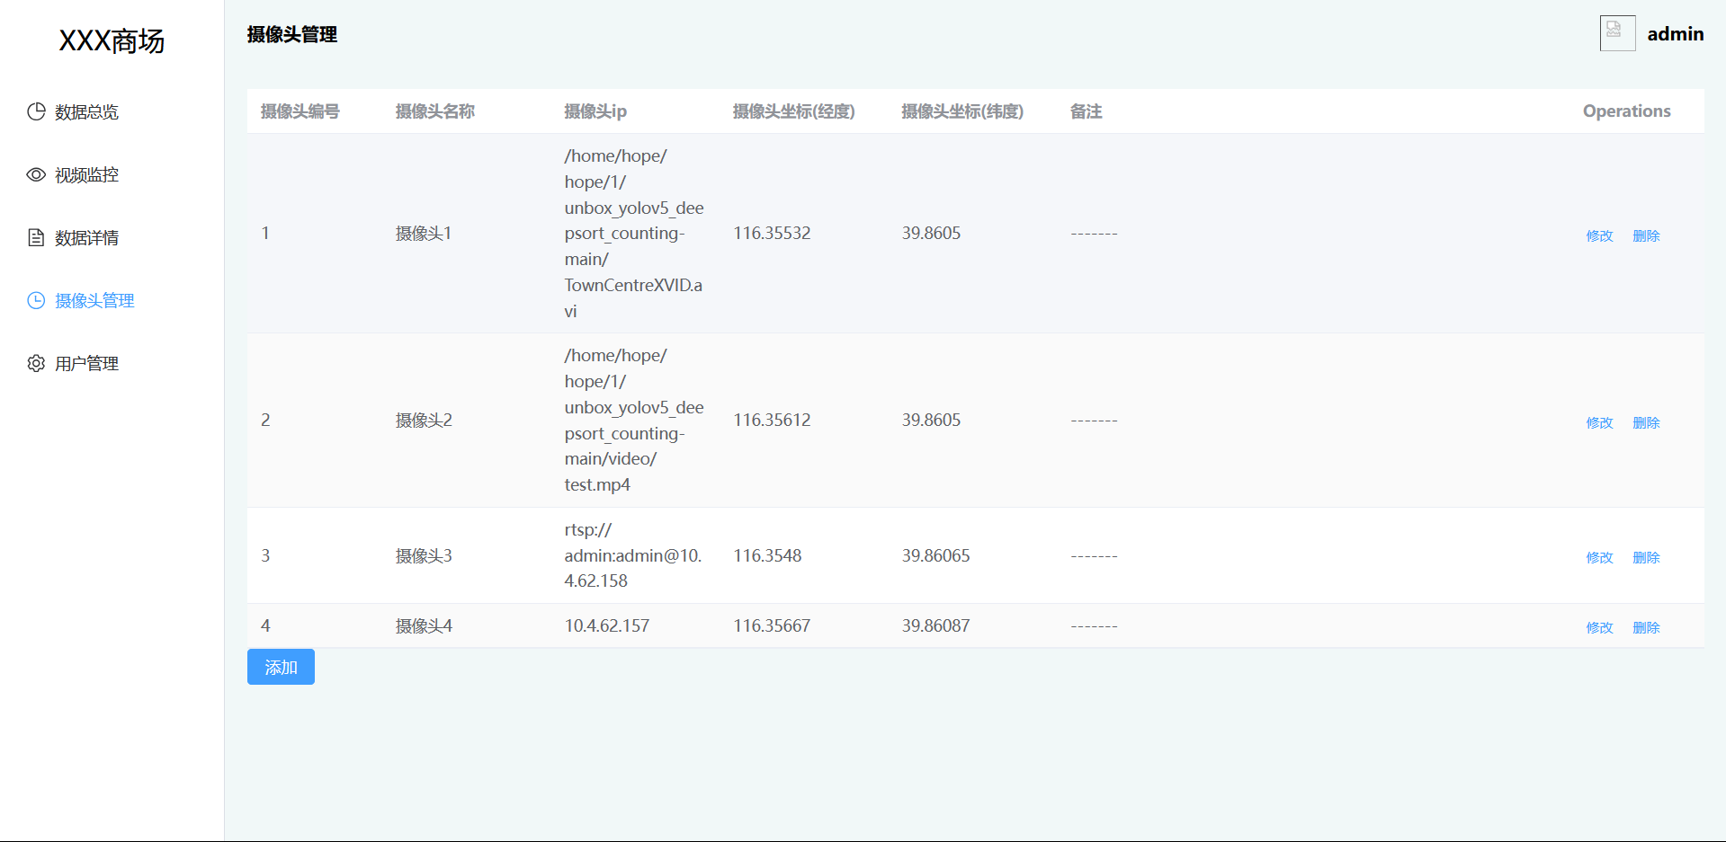
Interface prototype
Camera managemente
Notes:
While in new device panel, the user can manually create a new device and display the device information in the device table and device map. The module will first ask the user to fill in the basic information, then continue to ask the user to fill in the Setup Form, and finally ask the user to confirm the information before creating a device.

Slide 14
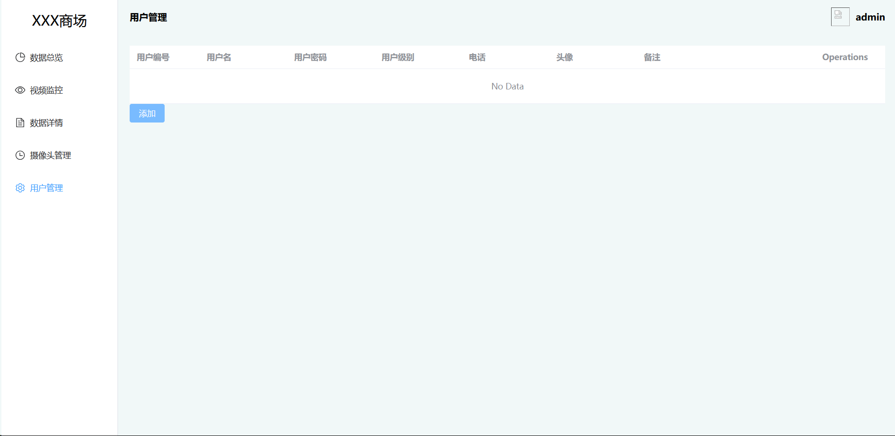
Interface prototype
User management
Notes:
The user information interface will show the user's scope of responsibility and organization. And show the latest alarms, debug notifications and verbose logs happened to the system.

Slide 15
Detailed Function Description
Design Ideas:
people flow
Visuali
zation
Flux - Real-Time People Monitoring Platform
Interface
scence
camera
Notes:
Now comes to functions. The detailed function description of the "Embedded Environment Monitoring System Client" project includes the following design ideas:
1. Real-time Data Monitoring: The client application will connect with embedded environmental sensors via the `MQTT` communication protocol to capture real-time data related to various environmental parameters, such as air quality, humidity, and temperature.
Next step, data Visualization. The application will provide visually appealing and intuitive data visualization to present the captured environmental data in a user-friendly manner. This includes charts, graphs, and other visual elements to help users interpret the data easily.
As for user Interface: The design will focus on creating a user-friendly interface that is easy to navigate and understand, catering to users with varying technical backgrounds. The interface will provide a seamless experience for accessing and interacting with the environmental data.
Finally , cloud Integration: The application will include functionality to upload the collected data to a cloud server, enabling remote access to the environmental data and facilitating data sharing with others.

Slide 16
Detailed Function Description
Problems Encountered:
Data Compatibility
User Experience
Different sensors may use different communication protocols or data formats
In order to meet the different needs and expectations of users, we need to consider accessibility and responsiveness and ease of use
Real-time Data Processing
Security and Privacy
When dealing with large amounts of data, latency and performance issues can occur
Protect collected environmental data from unauthorized access or tampering to ensure user privacy
Notes:
During the implementation process of the "Embedded Environment Monitoring System Client" project, some potential problems that could arise include Data Compatibility, Real-time Data Processing, User Experience and Security and Privacy.
1. Design a system and ensure compatibility and seamless integration with different types of embedded platforms and sensors, which may use data formats costs us some time to design.
2nd we will Manage a large volume of real-time data and ensure efficient processing and visualization without significant delays or performance issues.
3rd we Designed an intuitive and user-friendly interface that meets the diverse needs and expectations of users, considering factors such as accessibility, responsiveness, and ease of use.
4th we will implement appropriate security measures to protect the collected environmental data from unauthorized access or tampering, ensuring user privacy, and complying with relevant data protection regulations.

Slide 17
Project planning
and team division
PART THREE
Notes:
The third part is project time planning and team division of labor

Slide 18
Project scheduling
User testing and feedback
12.04 --- 12.08
System design and architecture
11.06 -- 11.12
Release and maintenance 12.09 --- 12.15
Project Planning &Requirements Analysis
10.30 -- 11.05
Development and testing 11.13 --- 12.03
Notes:
Our project consisted of five main stages: project planning and requirement analysis, system design and architecture, development and testing, user test and feedback, and release and maintenance.
In the first stage, we defined the project objectives and scope, collected user requirements and functional requirements, and formulated a detailed project plan. We spent one week on this stage, from October 30th to November 5th.
In the second stage, we will define the system architecture, design the database structure and data flow, and begin to develop the user interface and interaction design. We will also spend one week on this stage, from November 6th to November 12th.
In the third stage, we will implemente the system core function modules, and conducte unit testing and integration testing, and fix any bugs or errors. This was the longest stage, which will last for three weeks, from November 13th to December 3rd.
In the fourth stage, we will deliver the system to users for testing, and collect user comments for adjustment, repair and make some minor improvements base on user suggestions. We will spend one week on this stage, from December 4th to December 8th.
In the final stage, we will prepare for the official release, provide necessary documents and training, and offer continuous technical support and maintenance services. We complete this stage in one week, from December 9th to December 15th.

Slide 19
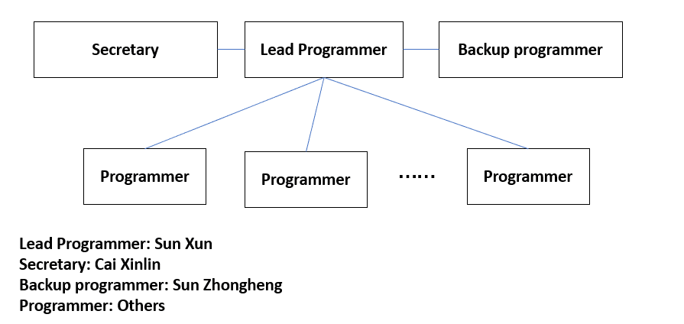
行业PPT模板http://www.1ppt.com/hangye/
Team management
We use an open model to organize our team. Open mode is a combination of closed mode and random mode
Closed mode
Random mode
Random models promote mutual trust. The skill assignment of the members is appropriate to the problem to be solved. Value the cohesion of the team.
Notes:
We use an open model to organize our teams. Open model is a kind of innovative combination of closed paradigm and random paradigm. The closed pattern, like the diagram at left side, represents the interrelationship between the lead programmer and other positions. This not only realizes the specialization of the division of labor, but also reduces the complexity of management and improves the work efficiency. And Random mode is a management method that advocates maintaining team cohesion promoting mutual trust..

Slide 20
Team management
teamwork
Assignment and priority setting, Regular team meetings, Effective communication, Knowledge Sharing, . Mutual support and encouragement, Feedback and improvement.
Team management methodology
Agile development
Under the agile development framework, implement iterative development, use Scrum methods, strive to form cross-functional teams, and insist on continuous feedback.
Notes:
Our team will insists on task segmentation, regular meetings, active communication and feedbacks. And the whole project is divided into short iterations, so that the members could give feedbacks to each other. We will also be committed to receiving user feedback, and adjust the project direction timely to ensure that the expectations of users are met.

Slide 21
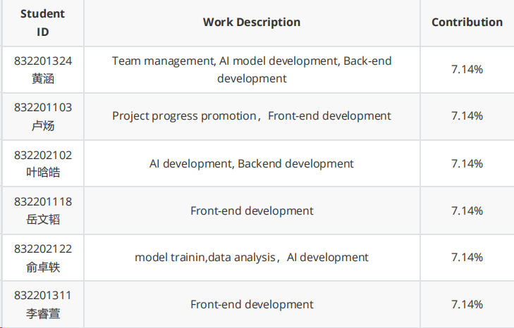

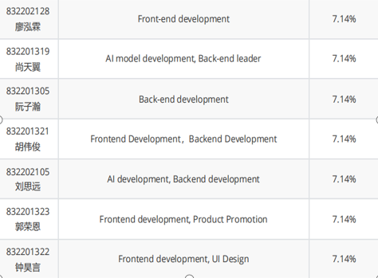

Team management
Notes:
Therefore, this is the specific division of labor in our team. Most of us will have some development tasks and we will keep our team members posted by hosting standing meetings weekly during the development process.

Slide 22
THANK YOU!
Notes:
That‘s all for today! Thank you for listening.

